Slide 1
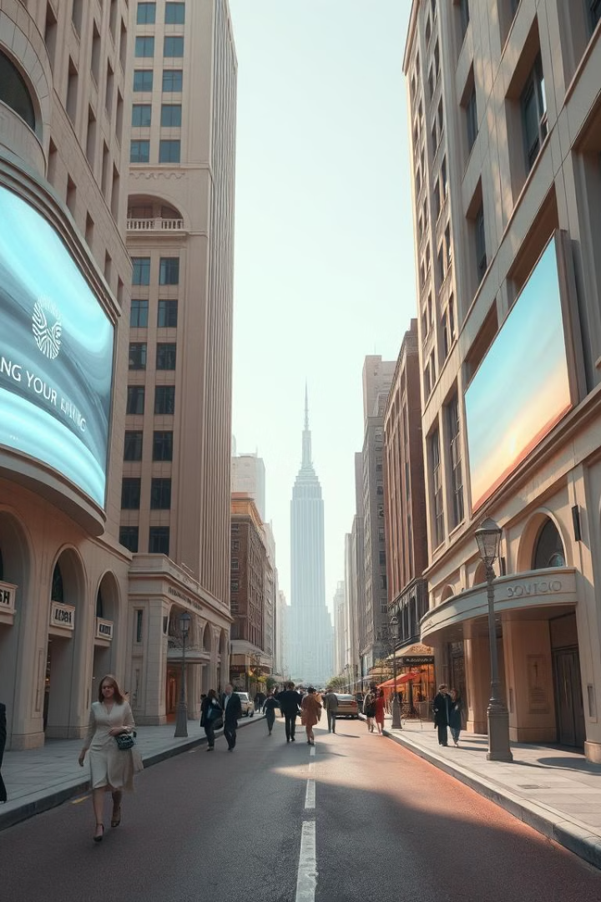
The Metaverse: Unlocking the Future of Digital Experiences
Welcome to the world of the Metaverse, a transformative technological landscape that promises to revolutionize the way we interact, learn, and work. This presentation delves into the fascinating world of the Metaverse, exploring its definition, evolution, applications, and potential. We'll examine the immersive technologies that power this burgeoning digital realm, while uncovering the exciting opportunities it holds for various industries and individuals alike.

Slide 2
What is the Metaverse?
A Shared Virtual Space
Beyond Gaming
Building a New Reality
The Metaverse is a collective term for a network of persistent, shared virtual spaces that are accessed through various digital devices, including VR headsets, augmented reality glasses, and smartphones. These spaces offer immersive experiences and opportunities for users to interact with each other and with virtual objects.
While initially associated with gaming, the Metaverse extends far beyond traditional entertainment. It encompasses a wide range of applications, including education, healthcare, retail, and social interaction. This evolving digital ecosystem holds the potential to transform many aspects of our lives.
The Metaverse is still in its early stages of development, but it has the potential to reshape our digital interactions, creating a new layer of reality where we can work, socialize, learn, and even own virtual assets. This is a world where the boundaries between the physical and digital realms continue to blur.

Slide 3
The Evolution of Virtual Worlds
1
2
3
Early Text-Based Games (1970s-1980s)
Graphical Virtual Worlds (1990s-2000s)
VR and AR Technologies (2010s-Present)
The seeds of the Metaverse were sown in the early days of computing with text-based games like "MUD" and "Multi-User Dungeons." These games allowed players to interact with each other and explore virtual environments, setting the stage for the immersive experiences to come.
With the advent of graphical interfaces, virtual worlds like "Second Life" and "Habbo Hotel" emerged, providing more immersive and visually engaging experiences. These platforms allowed users to create avatars, socialize, and participate in virtual economies, paving the way for the Metaverse we see today.
The rise of Virtual Reality (VR) and Augmented Reality (AR) technologies in recent years has accelerated the development of the Metaverse. These technologies allow users to fully immerse themselves in virtual environments, creating a more interactive and realistic experience.

Slide 4
Immersive Technologies Powering the Metaverse
Virtual Reality (VR)
Augmented Reality (AR)
Mixed Reality (MR)
VR technology creates immersive experiences by transporting users into computer-generated environments. Using headsets that track head movements and controllers, users can interact with the virtual world and other users in a highly engaging way.
AR overlays digital content onto the real world, enriching the user's perception of their surroundings. Through smartphones, tablets, or smart glasses, users can experience virtual objects, information, and interactions integrated into their physical environment.
MR blends elements of both VR and AR, creating a more interactive and integrated experience. Users can manipulate virtual objects in their real-world environment, fostering a seamless blend of digital and physical elements.

Slide 5
Metaverse Applications Across Industries
1
Education
2
Healthcare
The Metaverse offers exciting possibilities for education, enabling students to learn in immersive environments, participate in interactive simulations, and connect with educators and peers from around the world.
VR and AR technologies are being used in healthcare for patient education, rehabilitation, and medical training. Surgeons can practice complex procedures in virtual environments, while patients can experience interactive treatment plans and rehabilitation programs.
3
Retail
4
Entertainment
The Metaverse presents new opportunities for retailers to create engaging shopping experiences. Customers can virtually try on clothes, explore virtual stores, and interact with product information in immersive environments.
The Metaverse is already transforming the entertainment industry, with immersive games, concerts, and virtual events that offer new ways for people to connect and experience entertainment.

Slide 6




Monetization Opportunities in the Metaverse
Virtual Goods and Services
The Metaverse offers new avenues for creating and selling virtual goods and services, such as virtual clothing, accessories, tools, and experiences. Users can purchase these items using virtual currencies or NFTs, creating a thriving virtual economy.
Virtual Advertising
As the Metaverse becomes more popular, brands are exploring new ways to advertise their products and services within these virtual spaces. This could involve virtual billboards, branded events, or immersive product demonstrations.
Subscription Services
Subscription models are becoming increasingly popular in the Metaverse, with companies offering access to virtual worlds, services, and experiences for a recurring fee. This provides a consistent revenue stream for businesses while offering users ongoing access to the Metaverse.
Virtual Events and Experiences
The Metaverse offers unique opportunities for hosting virtual events, concerts, conferences, and other experiences that can attract large audiences and generate revenue through ticketing, merchandise sales, and sponsorships.

Slide 7

Bridging the Physical and Digital Realms
Physical World
Digital World
Physical objects and spaces
Virtual objects, environments, and experiences
Real-world interactions
Digital interactions and avatars
Physical commerce and services
Virtual commerce and services
Real-world data and information
Virtual data and information, including NFTs and blockchain

Slide 8




Metaverse Governance and Ethical Considerations
Privacy and Security
Inclusivity and Accessibility
Governance and Regulation
Social Responsibility
Protecting user data and ensuring privacy in the Metaverse is paramount. Measures must be in place to prevent data breaches, identity theft, and unauthorized access to personal information.
Metaverse developers and stakeholders have a responsibility to consider the social impact of their creations. This includes addressing potential issues like addiction, cyberbullying, and the ethical implications of virtual identities and interactions.
The Metaverse should be accessible and inclusive for everyone, regardless of their physical abilities or socio-economic background. Ensuring accessibility for all users is crucial for creating a truly equitable digital environment.
Establishing clear governance structures and ethical guidelines for the Metaverse is essential for ensuring responsible development and mitigating potential risks. This includes addressing issues related to virtual property ownership, content moderation, and legal disputes.

Slide 9
Navigating the Challenges of the Metaverse
1
Technological Limitations
2
User Experience
Current VR and AR technologies still have limitations, including latency, resolution, and battery life. Overcoming these technical hurdles is crucial for creating seamless and immersive Metaverse experiences.
Ensuring a positive and engaging user experience is crucial for the success of the Metaverse. This involves addressing issues like motion sickness, user interface design, and accessibility for different user demographics.
3
Security and Privacy
4
Ethical Considerations
Protecting user data and ensuring security within the Metaverse is paramount. This involves implementing robust cybersecurity measures, addressing potential risks of fraud, and ensuring user privacy is respected.
The Metaverse raises complex ethical questions related to virtual identity, ownership, and the impact on real-world society. Navigating these ethical challenges is essential for responsible development and a positive future for the Metaverse.

Slide 10
The Road Ahead: Metaverse Trends and Predictions
Decentralized Governance
Convergence of Technologies
The Metaverse is likely to embrace decentralized governance models, with communities and users having more control over the development and management of virtual spaces, leveraging blockchain technology.
We can expect to see the convergence of various technologies, including VR, AR, MR, blockchain, and artificial intelligence, creating a more immersive and interconnected Metaverse experience.
1
2
3
4
Growth of Virtual Economies
Increased Adoption
The Metaverse will foster the emergence of thriving virtual economies, with users buying, selling, and trading virtual assets, goods, and services using virtual currencies and NFTs.
The Metaverse will continue to gain traction, with more businesses, individuals, and organizations adopting its applications for education, healthcare, entertainment, and other sectors.

